Slide 1
Unit 6:
Architecture Design

Slide 2
Architecture Design
Architectural design is concerned with understanding how a system should be organized and designing the overall structure of that system.
In the model of the software development process architectural design is the first stage in the software design process.
It is the critical link between design and requirements engineering, as it identifies the main structural components in a system and the relationships between them.
The output of the architectural design process is an architectural model that describes how the system is organized as a set of communicating components.

Slide 3
Architecture Design
In agile processes, it is generally accepted that an early stage of the development process should be concerned with establishing an overall system architecture.
Incremental development of architectures is not usually successful. While refactoring components in response to changes is usually relatively easy, refactoring a system architecture is likely to be expensive.

Slide 4
Architecture Design
Architectural decomposition is usually necessary to structure and organize the specification.
Therefore, as part of the requirements engineering process, you might propose an abstract system architecture where you associate groups of system functions or features with large-scale components or sub-systems.

Slide 5
Architecture Design
You can design software architectures at two levels of abstraction
Architecture in the small
Architecture in the large
Architecture in the small
Architecture in the small is concerned with the architecture of individual programs. At this level, we are concerned with the way that an individual program is decomposed into components.
Architecture in the large
Architecture in the large is concerned with the architecture of complex enterprise systems that include other systems, programs, and program components.

Slide 6
Architecture Design
Software architecture is important because it affects the performance, robustness, distributability, and maintainability of a system .
In many systems, non-functional requirements are also influenced by individual components, but there is no doubt that the architecture of the system is the dominant influence.

Slide 7
Architecture Design
Bass et al. (2003) discuss three advantages of explicitly designing and documenting software architecture:
Stakeholder communication:
The architecture is a high-level presentation of the system that may be used as a focus for discussion by a range of different stakeholders.
System analysis:
Making the system architecture explicit at an early stage in the system development requires some analysis. Architectural design decisions have a profound effect on whether or not the system can meet critical requirements such as performance, reliability, and maintainability

Slide 8
Architecture Design
Bass et al. (2003) discuss three advantages of explicitly designing and documenting software architecture:
Large-scale reuse:
A model of a system architecture is a compact, manageable description of how a system is organized and how the components interoperate. The system architecture is often the same for systems with similar requirements and so can support large-scale software reuse

Slide 9
Architecture Design
System architectures are often modeled using simple block diagrams
Block diagrams present a high-level picture of the system structure, which people from different disciplines, who are involved in the system development process, can readily understand.
Block diagrams are an appropriate way of describing the system architecture during the design process, as they are a good way of supporting communications between the people involved in the process.

Slide 10
Architectural design decisions
Architectural design is a creative process where you design a system organization that will satisfy the functional and non-functional requirements of a system.
Because it is a creative process, the activities within the process depend on the type of system being developed, the background and experience of the system architect, and the specific requirements for the system.
It is therefore useful to think of architectural design as a series of decisions to be made rather than a sequence of activities

Slide 11
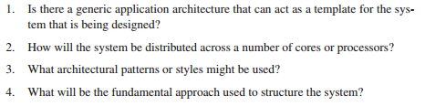
Architectural design decisions
During the architectural design process, system architects have to make a number of structural decisions that profoundly affect the system and its development process.
Based on their knowledge and experience, they have to consider the following fundamental questions about the system:

Slide 12
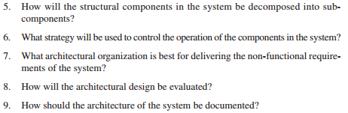
Architectural design decisions

Slide 13
Architectural design decisions
The architecture of a software system may be based on a particular architectural pattern or style.
An architectural pattern is a description of a system organization (Garlan and Shaw, 1993), such as a client–server organization or a layered architecture.
Architectural patterns capture the essence of an architecture that has been used in different software systems.
You should be aware of common patterns, where they can be used, and their strengths and weaknesses when making decisions about the architecture of a system.

Slide 14
Architectural design decisions
Because of the close relationship between non-functional requirements and software architecture, the particular architectural style and structure that you choose for a system should depend on the non-functional system requirements:
1. Performance
If performance is a critical requirement, the architecture should be designed to localize critical operations within a small number of components, with these components all deployed on the same computer rather than distributed across the network.
This may mean using a few relatively large components rather than small, fine-grain components, which reduces the number of component communications.
You may also consider run-time system organizations that allow the system to be replicated and executed on different processors

Slide 15
Architectural design decisions
2. Security
If security is a critical requirement, a layered structure for the architecture should be used, with the most critical assets protected in the innermost layers, with a high level of security validation applied to these layers.
3. Safety
If safety is a critical requirement, the architecture should be designed so that safety-related operations are all located in either a single component or in a small number of components. This reduces the costs and problems of safety validation and makes it possible to provide related protection systems that can safely shut down the system in the event of failure.

Slide 16
Architectural design decisions
4. Availability
If availability is a critical requirement, the architecture should be designed to include redundant components so that it is possible to replace and update components without stopping the system.
5. Maintainability
If maintainability is a critical requirement, the system architecture should be designed using fine-grain, self-contained components that may readily be changed. Producers of data should be separated from consumers and shared data structures should be avoided.
Evaluating an architectural design is difficult because the true test of an architecture is how well the system meets its functional and non-functional requirements when it is in use.

Slide 17
Architectural View
In the introduction to this chapter that architectural models of a software system can be used to focus discussion about the software requirements or design.
Alternatively, they may be used to document a design so that it can be used as a basis for more detailed design and implementation, and for the future evolution of the system.
In Architectural view two issues that are relevant to both of these:
What views or perspectives are useful when designing and documenting a system’s architecture?
What notations should be used for describing architectural models?

Slide 18
Architectural View
There are different opinions as to what views are required. Krutchen (1995), in his well-known 4+1 view model of software architecture, suggests that there should be four fundamental architectural views, which are related using use cases or scenarios. The views that he suggests are:
A logical view: which shows the key abstractions in the system as objects or object classes. It should be possible to relate the system requirements to entities in this logical view.
A process view: which shows how, at run-time, the system is composed of interacting processes. This view is useful for making judgments about nonfunctional system characteristics such as performance and availability

Slide 19
Architectural View
A development view: which shows how the software is decomposed for development, that is, it shows the breakdown of the software into components that are implemented by a single developer or development team. This view is useful for software managers and programmers.
A physical view: which shows the system hardware and how software components are distributed across the processors in the system. This view is useful for systems engineers planning a system deployment.

Slide 20
Architectural View
Hofmeister et al. (2000) suggest the use of similar views but add to this the notion of a conceptual view.
This view is an abstract view of the system that can be the basis for decomposing high-level requirements into more detailed specifications, help engineers make decisions about components that can be reused, and represent a product line rather than a single system.

Slide 21
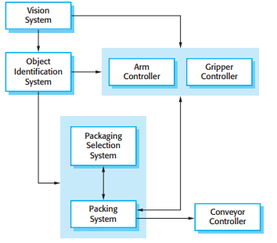
Architectural View
The architecture of a packing robot, is an example of a conceptual system view.

Slide 22
Architectural View
There are differing views about whether or not software architects should use the UML for architectural description (Clements, et al., 2002).
A survey in 2006 (Lange et al., 2006) showed that, when the UML was used, it was mostly applied in a loose and informal way.
The UML was designed for describing object-oriented systems and, at the architectural design stage, you often want to describe systems at a higher level of abstraction. Object classes are too close to the implementation to be useful for architectural description

Slide 23
Architectural View
A number of researchers have proposed the use of more specialized architectural description languages (ADLs) (Bass et al., 2003) to describe system architectures.
The basic elements of ADLs are components and connectors, and they include rules and guidelines for well-formed architectures. However, because of their specialized nature, domain and application specialists find it hard to understand and use ADLs.
This makes it difficult to assess their usefulness for practical software engineering. ADLs designed for a particular domain (e.g., automobile systems) may be used as a basis for model-driven development.

Slide 24
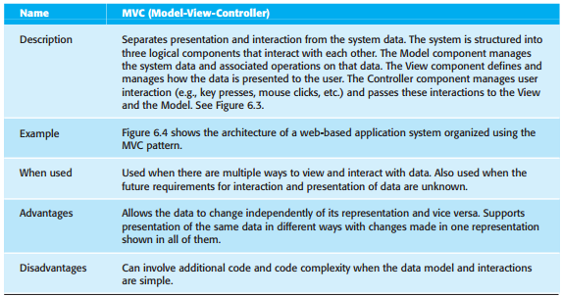
The model view-controller (MVC) pattern

Slide 25
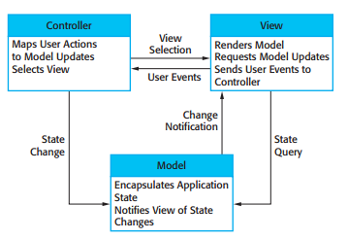
Figure 6.3 The organization of the MVC

Slide 26
Architectural Patterns
An architectural pattern as a stylized, abstract description of good practice, which has been tried and tested in different systems and environments.
An architectural pattern should describe a system organization that has been successful in previous systems.
It should include information of when it is and is not appropriate to use that pattern, and the pattern’s strengths and weaknesses.

Slide 27
Architectural Patterns
Example
Model-View-Controller pattern.
This pattern is the basis of interaction management in many web-based systems.
The stylized pattern description includes the pattern name, a brief description (with an associated graphical model), and an example of the type of system where the pattern is used (again, perhaps with a graphical model).
You should also include information about when the pattern should be used and its advantages and disadvantages.

Slide 28
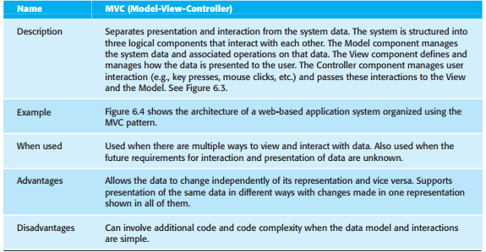
Architectural Patterns
Model-View-Controller pattern.

Slide 29
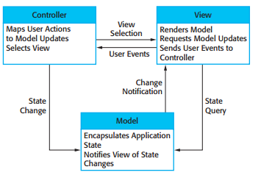
Architectural Patterns
Model-View-Controller pattern.
Graphical models of the architecture associated with the MVC pattern
Conceptual View: The organization of the MVC

Slide 30
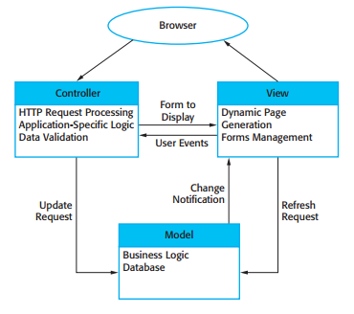
Architectural Patterns
Model-View-Controller pattern.
Graphical models of the architecture associated with the MVC pattern
Run-time architecture : Web application architecture using the MVC pattern

Slide 31
Architectural Patterns
Model-View-Controller pattern.
The architecture from different views— a conceptual view and run-time architecture : this pattern is used for interaction management in a web-based system.

Slide 32
Architectural Patterns
Layered architecture
The notions of separation and independence are fundamental to architectural design because they allow changes to be localized.
For Example:
The MVC pattern, separates elements of a system, allowing them to change independently. For example, adding a new view or changing an existing view can be done without any changes to the underlying data in the model.
Next is:
The layered architecture pattern is another way of achieving separation and independence. Here, the system functionality is organized into separate layers, and each layer only relies on the facilities and services offered by the layer immediately beneath it.

Slide 33
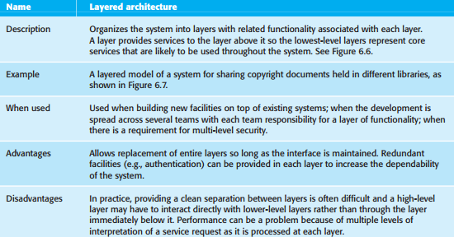
Architectural Patterns
Here, the system functionality is organized into separate layers, and each layer only relies on the facilities and services offered by the layer immediately beneath it.

Slide 34
Architectural Patterns
Layered architecture
This layered approach supports the incremental development of systems.
As a layer is developed, some of the services provided by that layer may be made available to users.
The architecture is also changeable and portable.
So long as its interface is unchanged, a layer can be replaced by another, equivalent layer.
Furthermore, when layer interfaces change or new facilities are added to a layer, only the adjacent layer is affected.
As layered systems localize machine dependencies in inner layers, this makes it easier to provide multi-platform implementations of an application system.
Only the inner, machine-dependent layers need be re-implemented to take account of the facilities of a different operating system or database

Slide 35
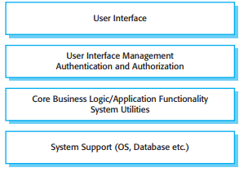
Architectural Patterns
Layered architecture
Figure 6.6 A generic layered architecture

Slide 36
Architectural Patterns
Layered architecture
Figure 6.6 is an example of a layered architecture with four layers.
The lowest layer includes system support software—typically database and operating system support.
The next layer is the application layer that includes the components concerned with the application functionality and utility components that are used by other application components.
The third layer is concerned with user interface management and providing user authentication and authorization.
The top layer providing user interface facilities.
Of course, the number of layers is arbitrary. Any of the layers in Figure 6.6 could be split into two or more layers.

Slide 37
Architectural Patterns
Layered architecture
Figure 6.7 is an example of how this layered architecture pattern can be applied to a library system called LIBSYS, which allows controlled electronic access to copyright material from a group of university libraries.
This has a five-layer architecture, with the bottom layer being the individual databases in each library

Slide 38
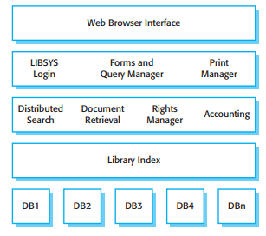
Architectural Patterns
Layered architecture
This has a five-layer architecture, with the bottom layer being the individual databases in each library
The architecture of the LIBSYS system

Slide 39
Architectural Patterns
Repository architecture
The Repository pattern describes how a set of interacting components can share data.
The majority of systems that use large amounts of data are organized around a shared database or repository.
This model is therefore suited to applications in which data is generated by one component and used by another.
Examples of this type of system include command and control systems, management information systems, CAD systems, and interactive development environments for software

Slide 40
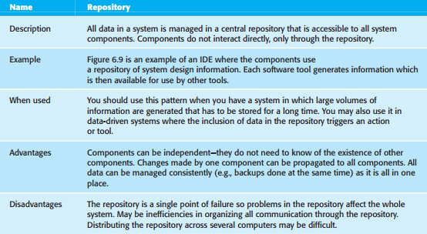
Architectural Patterns
Repository architecture

Slide 41
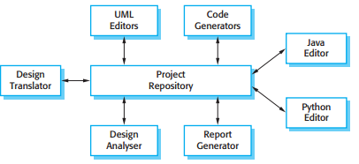
Architectural Patterns
Repository architecture
Figure 6.9 A repository architecture for an IDE

Slide 42
Architectural Patterns
Repository architecture
Figure 6.9 is an illustration of a situation in which a repository might be used.
This diagram shows an IDE that includes different tools to support model-driven development.
The repository in this case might be a version-controlled environment that keeps track of changes to software and allows rollback to earlier versions

Slide 43
Architectural Patterns
Repository architecture
Organizing tools around a repository is an efficient way to share large amounts of data.
There is no need to transmit data explicitly from one component to another.
However, components must operate around an agreed repository data model.
Inevitably, this is a compromise between the specific needs of each tool and it may be difficult or impossible to integrate new components if their data models do not fit the agreed schema.
In practice, it may be difficult to distribute the repository over a number of machines.
Although it is possible to distribute a logically centralized repository, there may be problems with data redundancy and inconsistency.

Slide 44
Architectural Patterns
Client–server architecture
The repository pattern is concerned with the static structure of a system and does not show its run-time organization.
A very commonly used run-time organization for distributed systems is the Client–server pattern .

Slide 45
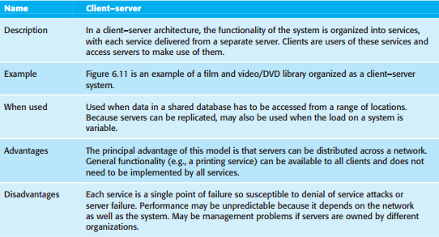
Architectural Patterns
Client–server architecture
The client–server pattern

Slide 46
Architectural Patterns
Client–server architecture
A system that follows the client–server pattern is organized as a set of services and associated servers, and clients that access and use the services.
The major components of this model are:
A set of servers that offer services to other components. Examples of servers include print servers that offer printing services, file servers that offer file management services, and a compile server, which offers programming language compilation services.
A set of clients that call on the services offered by servers. There will normally be several instances of a client program executing concurrently on different computers.

Slide 47
Architectural Patterns
Client–server architecture
A network that allows the clients to access these services. Most client–server systems are implemented as distributed systems, connected using Internet protocols.

Slide 48
Architectural Patterns
Client–server architecture
Client–server architectures are usually thought of as distributed systems architectures but the logical model of independent services running on separate servers can be implemented on a single computer.
Again, an important benefit is separation and independence.
Services and servers can be changed without affecting other parts of the system.
Clients may have to know the names of the available servers and the services that they provide.
However, servers do not need to know the identity of clients or how many clients are accessing their services.
Clients access the services provided by a server through remote procedure calls using a request-reply protocol such as the http protocol used in the WWW. Essentially, a client makes a request to a server and waits until it receives a reply.

Slide 49
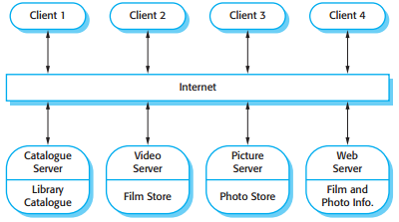
Architectural Patterns
Client–server architecture
Figure 6.11 A client— server architecture for a film library

Slide 50
Architectural Patterns
Client–server architecture
The most important advantage of the client–server model is that it is a distributed architecture.
Effective use can be made of networked systems with many distributed processors.
It is easy to add a new server and integrate it with the rest of the system or to upgrade servers transparently without affecting other parts of the system.

Slide 51
Architectural Patterns
Pipe and filter architecture
This is a model of the run-time organization of a system where functional transformations process their inputs and produce outputs.
Data flows from one to another and is transformed as it moves through the sequence.
Each processing step is implemented as a transform.
Input data flows through these transforms until converted to output.
The transformations may execute sequentially or in parallel.
The data can be processed by each transform item by item or in a single batch.

Slide 52
Architectural Patterns
Pipe and filter architecture
Variants of this pattern have been in use since computers were first used for automatic data processing.
When transformations are sequential with data processed in batches, this pipe and filter architectural model becomes a batch sequential model, a common architecture for data processing systems (e.g., a billing system).
The architecture of an embedded system may also be organized as a process pipeline, with each process executing concurrently.

Slide 53
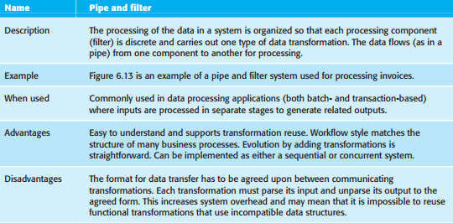
Architectural Patterns
Pipe and filter architecture
The pipe and filter pattern

Slide 54
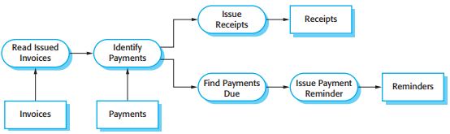
Architectural Patterns
Pipe and filter architecture
Figure 6.13 An example of the pipe and filter architecture

Slide 55
Architectural Patterns
Pipe and filter architecture
An example of this type of system architecture, used in a batch processing application, is shown in Figure 6.13.
An organization has issued invoices to customers.
Once a week, payments that have been made are reconciled with the invoices.
For those invoices that have been paid, a receipt is issued. For those invoices that have not been paid within the allowed payment time, a reminder is issued

